Slide 1

* BLINKIT –PRESENTATION *
Title: Analyzing Blink it Sales Data: Insights through Dashboards and Visualizations. Subtitle: Using Tableau, Power BI, Seaborn, and Matplotlib, Excel Presented by: [SHUSHREE PRANATI SWAIN] Date: [05-05-2025]
Guided by-
Mrs. Ritu Maity

Slide 2
Dataset Overview:
Source: CSV file containing grocery sales data.
Total Records: [8,523 number of records]
Key Columns:
Item Identifier
Item Weight
Item Fat Content
Item Visibility
Item Type
Outlet Identifier
Outlet Establishment Year
Outlet Size
Outlet Location Type
Outlet Type
Item Outlet Sales
Sales
Rating

Slide 3
Column Descriptions:
Item Identifier:
Categories:Ex-FDX32, NCB42
Helps in tracking and analyzing individual product sales.
Item Fat Content:
Categories:
Regular, Low Fat
Useful for understanding consumer preferences and dietary trends.
Item Type:
Description:
The category or type of product.
Examples:
Fruits and Vegetables, Health and Hygiene, Frozen Foods, Canned, Soft Drinks, Snack Foods, Dairy.

Slide 4
Column Descriptions:
Outlet Establishment Year
Description:
The year in which the store was established.
Outlet Identifier
Description:
A unique identifier for each store in the dataset.
Example: OUT049, OUT018
Essential for tracking sales performance by store.
Outlet Location Type
Description:
The type of city or region in which the store is located.
Categories:
Tier 1, Tier 2, Tier 3
Helps in understanding market dynamics based on location.

Slide 5
Column Descriptions:
Outlet Size:
Description:
The size of the store in terms of ground area covered.
Categories:
Small, Medium, High
Outlet Type:
Description:
Indicates whether the store is a grocery store or a supermarket.
Categories:
Supermarket Type1, Supermarket Type2, Supermarket Type3, Grocery Store
Item Visibility:
Description:
The percentage of the total display area in the store allocated to the specific product.

Slide 6
Column Descriptions:
Item Weight:
Description:
The weight of the product
Sales:
Description:
The sales of the product in the particular store (outcome variable).
Rating:
Description:
Customer rating of the product
8,523 rows and 12 columns of supermarket sales data
Sales is the primary focus as an output variable .

Slide 7
Blink it Analysis
BUSINESS REQUIREMENT
To conduct a comprehensive analysis of Blinkit's sales performance, customer satisfaction, and inventory distribution to identify key insights and opportunities for optimization using various KPIs and visualizations in Power BI, Excel, Tableau.
KPI’s Requirements
Total Sales: The overall revenue per sale.
Number of Items: The total count of generated from all items sold.
Average Sales: The average revenue different items sold.
Average Rating: The average customer rating for items sold.
Top Performing Item Types: Fruits and Vegetables, Snack Foods
Sales by Outlet Location Type: Tier 1 outlets outperform Tier 3

Slide 8
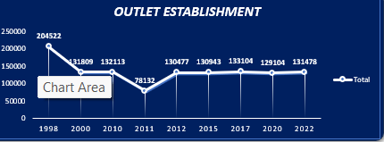
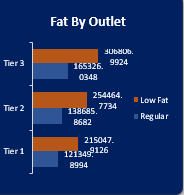
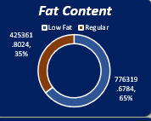
Describe the chart
Line Chart
Bar Chart
Daunts chart
This chart -Highlight the overall trend in total sales over the years.
Mention that the Grand Total of sales from 1998 to 2022 is approximately 1,201,681.
This chart- Highlight the overall trend in total sales over the Outlet Location.
Low Fat products consistently have higher sales than Regular products across all tiers. This indicates a growing consumer preference for healthier options.
This Chart-As you can see in the pie chart, we have two main categories: Low Fat and Regular products."
"The total sales amount to approximately $1,201,681.48

Slide 9
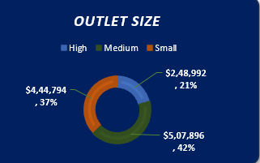
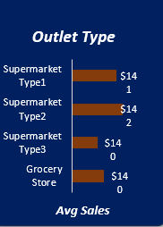
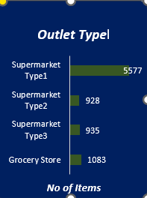
Describe the chart
Daunts Chart
Bar Chart
Bar chart
This chart -Highlight the overall trend in total sales over the Outlet Size.
In this pie chart, we can see the total sales amounting to approximately $1,201,681."
"The chart is divided into three segments representing the sales figures for High, Medium, and Small categories.
This chart- Highlight the overall trend in Avg sales over the Outlet Type.
In this bar chart, we can see the average total sales for each store type.
This Chart-. Highlight the overall trend in No of Item over the Outlet Type.
"The No of Items approximately 5577.

Slide 10
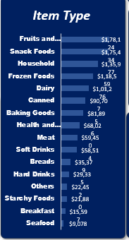
Describe the chart
In this bar chart, we can see the total sales figures for each food category.
From the chart, we can see that Fruits and Vegetables lead in total sales, indicating a strong consumer preference for fresh produce."
"Following closely are Snack Foods and Household items, which also show significant sales figures."
"On the other hand, categories like Seafood and Breakfast have the lowest sales, suggesting potential areas for growth or marketing focus."

Slide 11
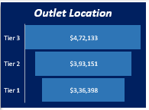
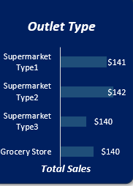
Describe the chart
Funnel Chart
In this funnel chart, we can see the total sales figures for each tier."
"The widest part of the funnel represents Tier 3, followed by Tier 2, and finally Tier 1 at the narrowest point
Bar Chart:
In this bar chart, we can see the total sales figures for each store type.
As we can see, Supermarket Type 1 significantly outperforms the other store types in terms of total sales.

Slide 12
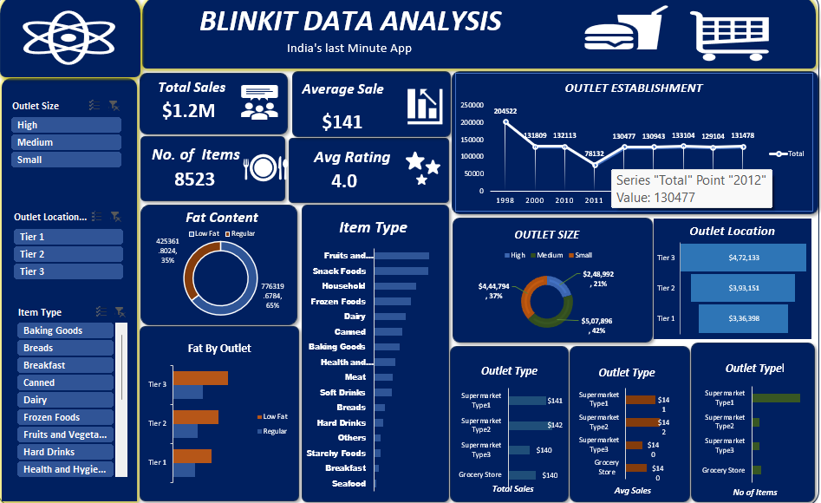
Excle Dashboard
In Excel Dashboard:
Bar charts showing sales by Item Fat Content and Outlet Type
Line charts for sales trends over time based on Outlet Establishment Year .
Area chart visualizing year of Outlet Establishment.
Dounts chart visualizing Fat content.
Funnel chart visualizing Outlet Location.
Bar chart Visualizing Total sales By Item types.

Slide 13

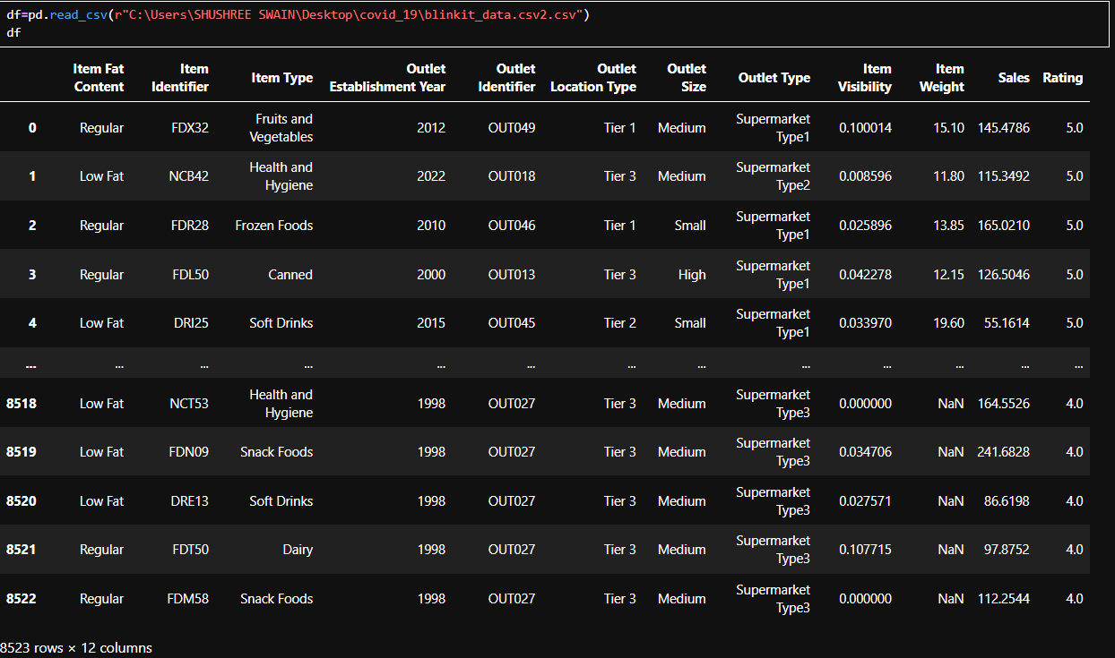
Python data analysis
Import:
Import The Libreary
Read The CSV. Files:
Data set over views.

Slide 14
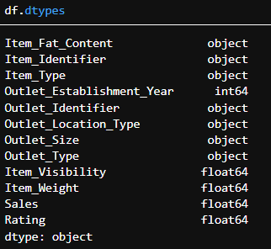
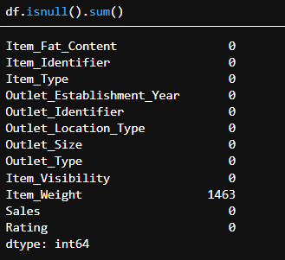
Python data analysis
Check The Null Value:I came to know that there is no null value expect in the Item weight Filed.
Checked The Data Types:

Slide 15



Python data analysis
Check The Unique value:
Change The null Value
Check The Statiscal value

Slide 16
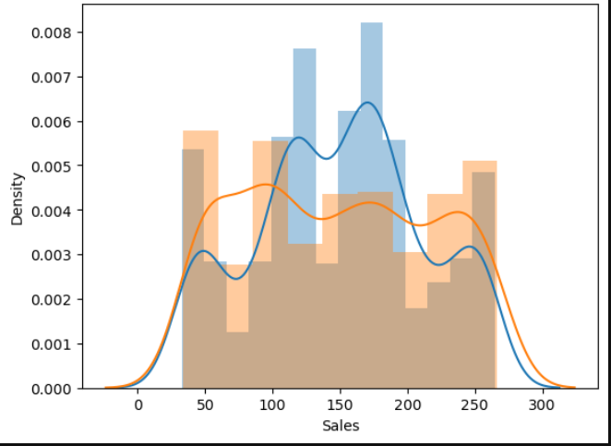
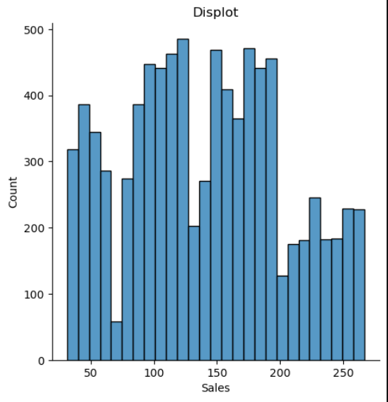
Python –Data Visualization
DistPlot:
Household sales distribution:
"We can observe where sales tend to cluster, showing the most common sales values for Household items."
For Dairy sales:
"The distribution may be slightly different, showing how Dairy product sales vary compared to Household items."
By comparing the two distributions on the same chart, we can easily see differences in sales patterns between these categories.
Displot:
In this distribution plot, we are looking at the sales figures represented on the x-axis.
The y-axis shows the density, which indicates how frequently sales amounts occur within certain ranges.
The plot provides a visual representation of the distribution of sales data

Slide 17
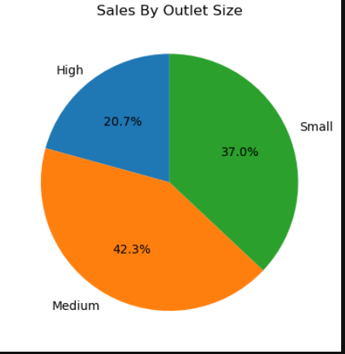
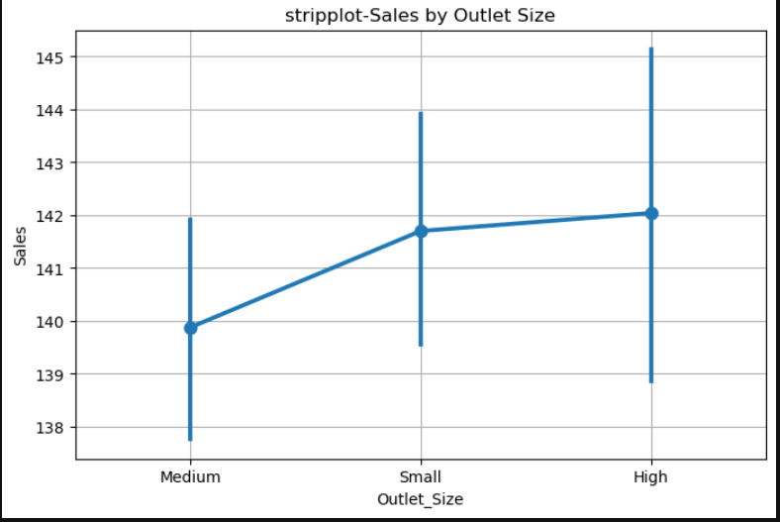
Python –Data Visualization
PointPlot: In this point plot, the x-axis represents the different outlet sizes, while the y-axis shows the corresponding sales figures."
Each point on the plot represents the average sales for each outlet size category.
we can observe how sales performance differs by outlet size.
Pie chart:
This pie chart shows the distribution of total sales across different outlet sizes. Each colored slice represents an outlet size category like Small, Medium, or Large. The numbers on the chart show the percentage share of total sales that each outlet size contributes.

Slide 18
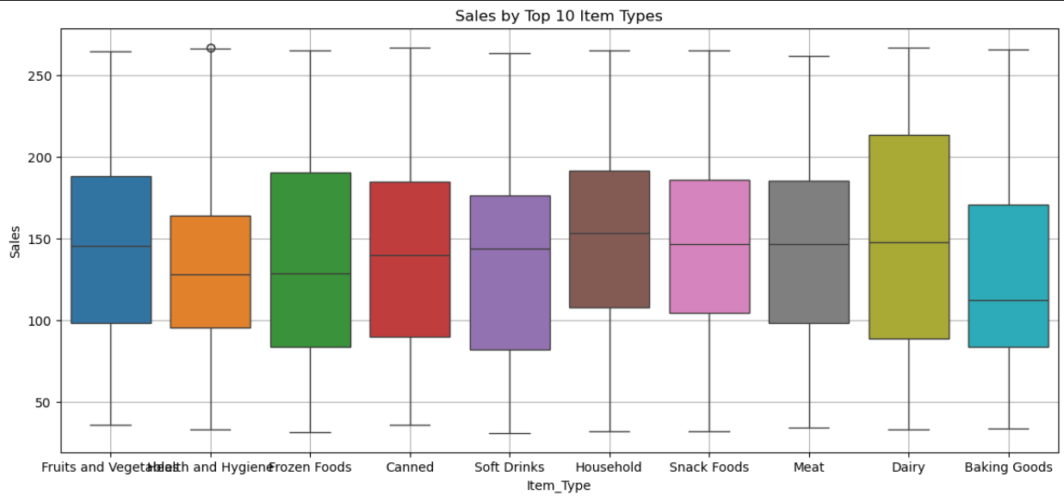
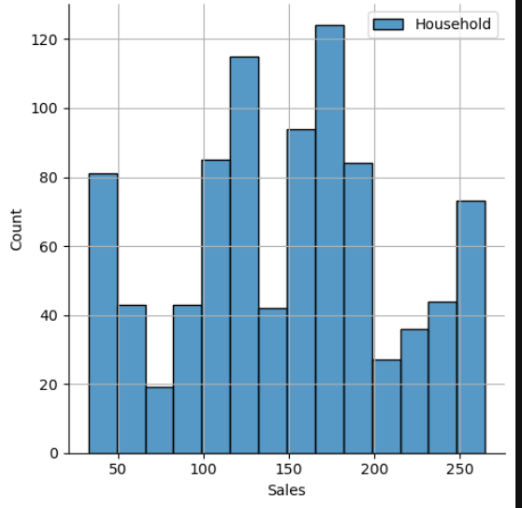
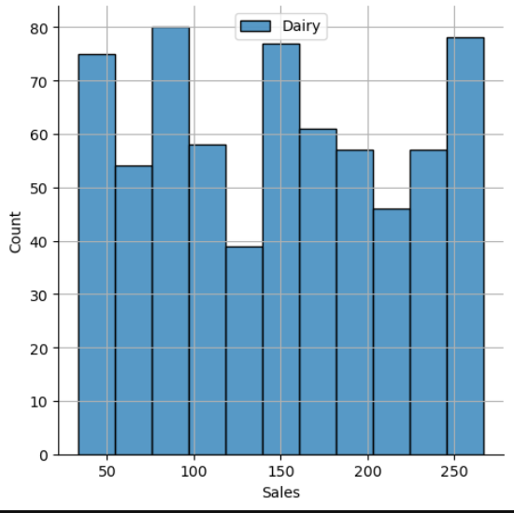
Python –Data Visualization
Box Plot: This boxplot illustrates the sales distribution for the top 10 item types in our dataset. Each box represents the range of sales for a specific item type, with the median sales value indicated by a line inside the box. The whiskers show the overall range of sales, while any points outside the whiskers are outliers. This visualization helps us understand how sales vary among the most popular item types, allowing us to identify trends and potential areas for improvement in our sales strategy
Displot:
This visualization consists of two distribution plots showing the sales data for 'Household' and 'Dairy' item types. Each plot illustrates how sales values are distributed, with the x-axis representing sales amounts and the y-axis showing the density of those sales. The legend helps us identify which distribution corresponds to which item type. By analyzing these distributions, we can gain insights into the sales performance of these categories, such as identifying trends, variability, and potential areas for improvement in our sales strategy.

Slide 19
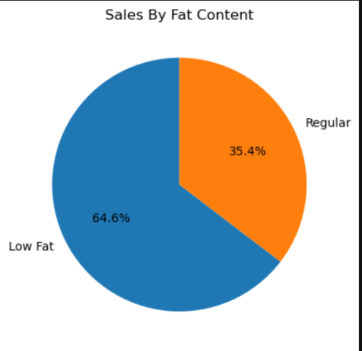
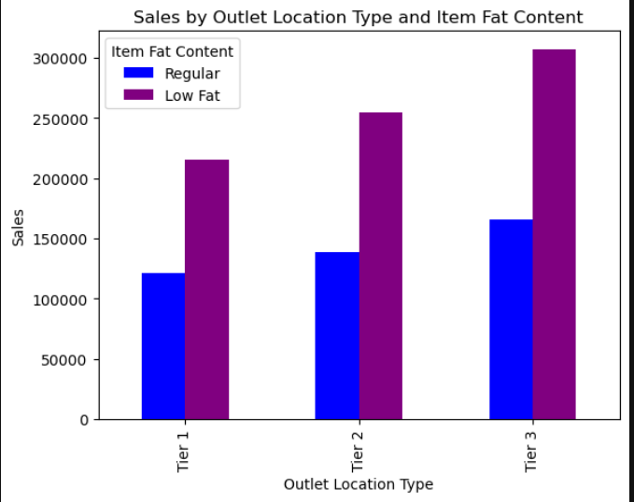
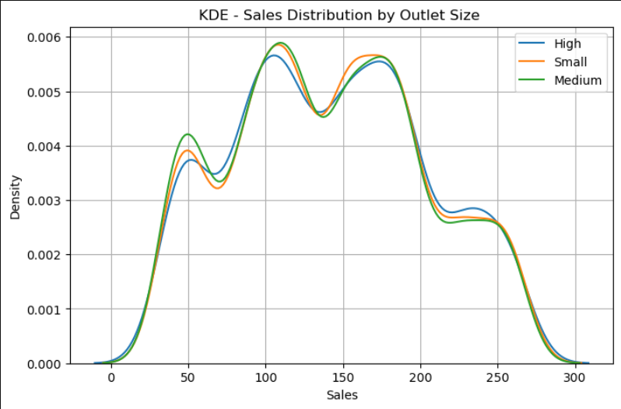
Python –Data Visualization
Pie Plot: we can see how sales are distributed among the different fat content categories. For instance, we can identify which category has the highest sales and any surprising trends.
Bar plot: we can observe how sales differ between 'Regular' and 'Low Fat' items across various outlet location types. [Point out specific trends or insights, such as which outlet type has the highest sales for each fat content category.
KDE plot: we can observe the sales distribution for each outlet size. [Point out specific trends, such as which outlet size has the highest sales density or any overlaps between the distributions.] This analysis helps us understand how sales performance varies with outlet size.

Slide 20
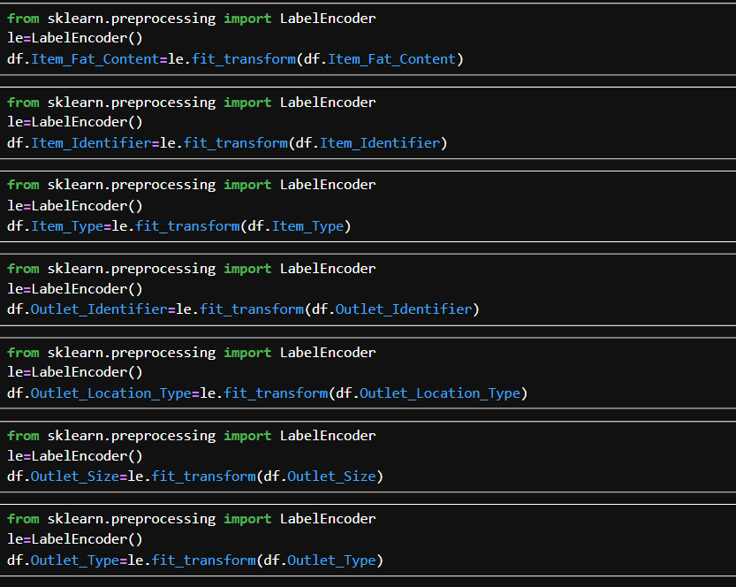
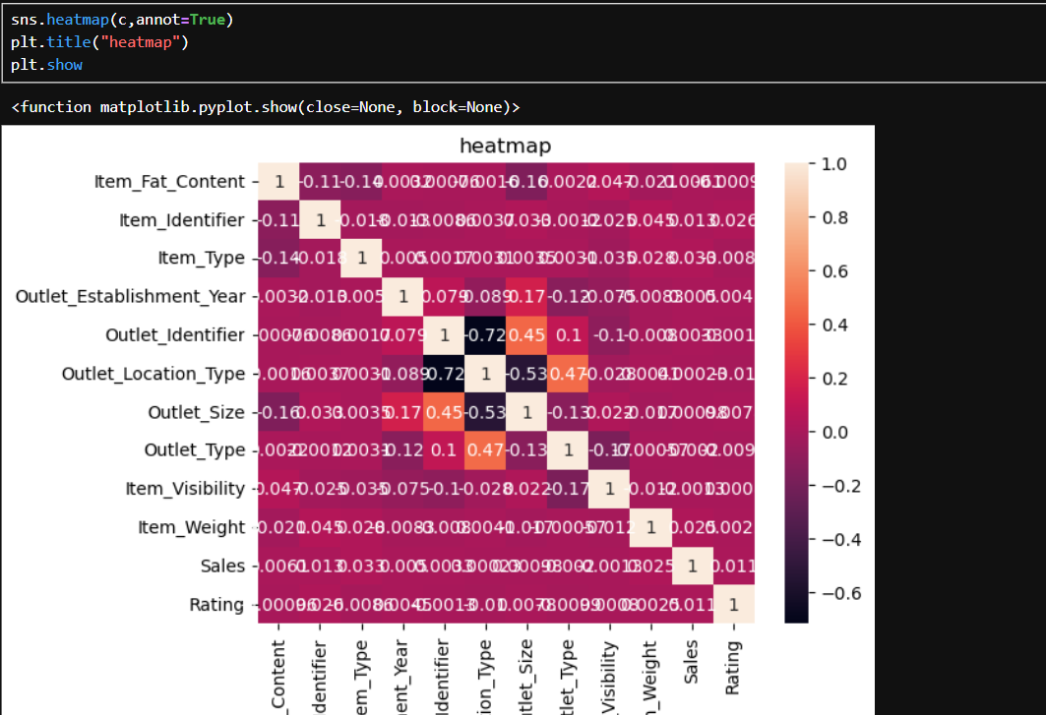
Label Encoding:- To covert string data in numerical data.
Heat Map;-To Visualize The Corelation.

Slide 21
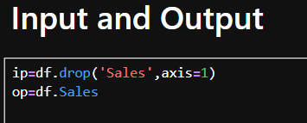

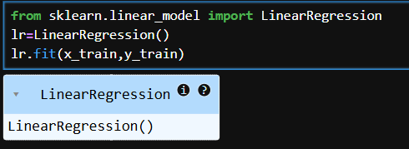
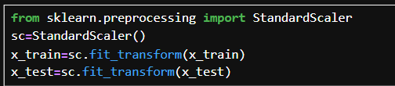
Train-Test-Split:-
Splitting the data for training and testing the machine.
Input And Output:
Input-For Train.
Output-For Test
Import The standard Scaler: To bring the data into a single range.
Import The Liner Regression:

Slide 22
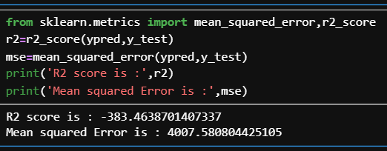
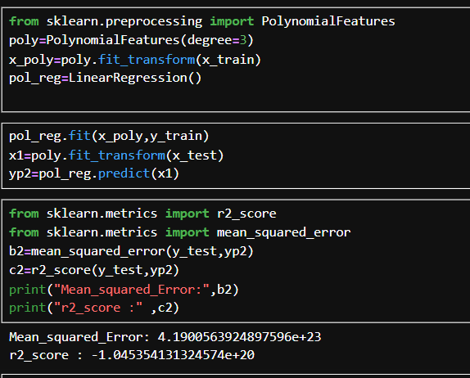
Import Mean-squared-Error , R2_Score:-
Import Polynomial Regression:

Slide 23
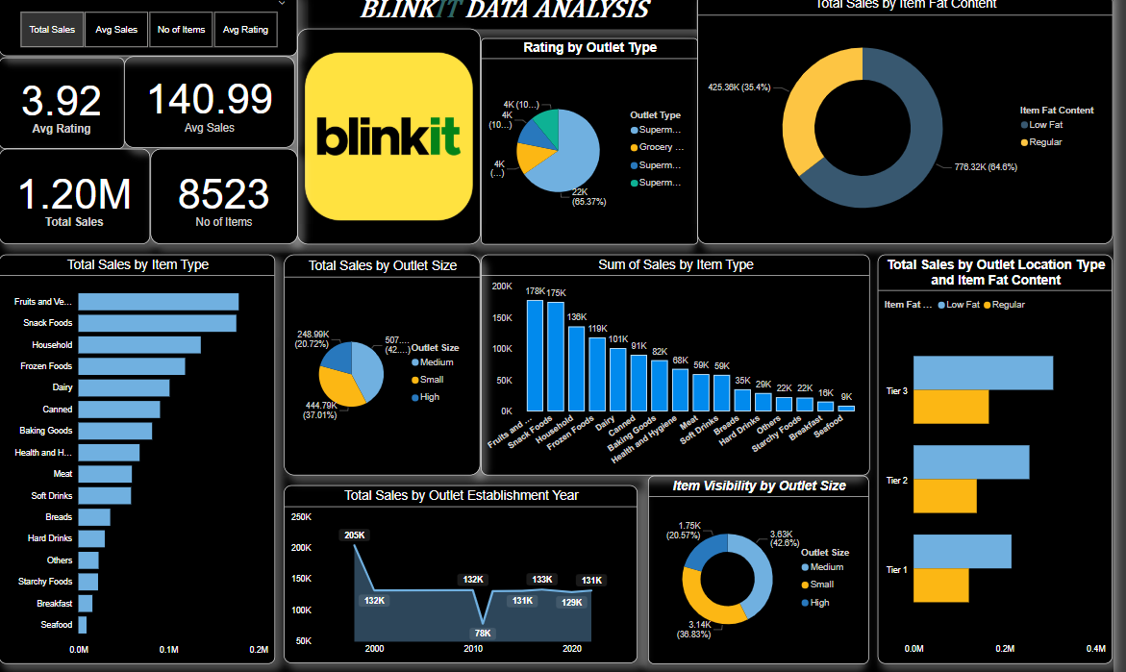
Power BI Dashboard
In Power Bi Dashboard:
Bar charts showing sales by Item Fat Content and Outlet Type
Line charts for sales trends over time based on Outlet Establishment Year .
Area chart visualizing year of Outlet Establishment.
Dounts chart visualizing Fat content.
Funnel chart visualizing Outlet Location.
Bar chart Visualizing Total sales By Item types.

Slide 24
Conclusion:
Key Findings:
Identify top-performing item types and outlets.
Understand the impact of item visibility and fat content on sales.
Future Work:
Further analysis on customer demographics and purchasing behavior.
Explore machine learning models for sales prediction.
* Thank You *

